Slide 1
IMAGE PLAYER
TEAM 9
Arun Das
Avishek Kumar Sharma
Jugnu Gill
Ritvik Gupta

Slide 2
INTRODUCTION
SAVimage is a web-based application that lets one edit an image in real-time.
The application provides a variety of filters and features which the user can interact with to get the desired image.
The application also let’s you capture images in real time and then apply filters on it.

Slide 3
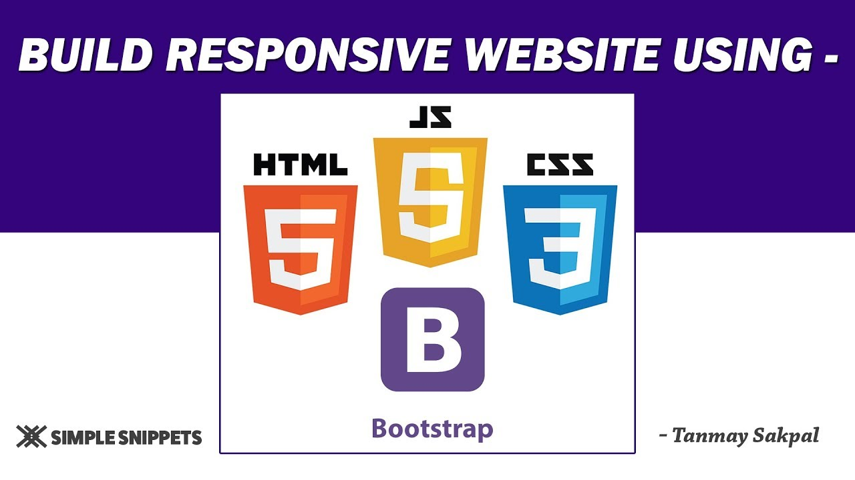

TECHNOLOGY STACK

Slide 4
FILTERS
Basic Filters
Image Transformation
Advanced Filters
AI Filters

Slide 5
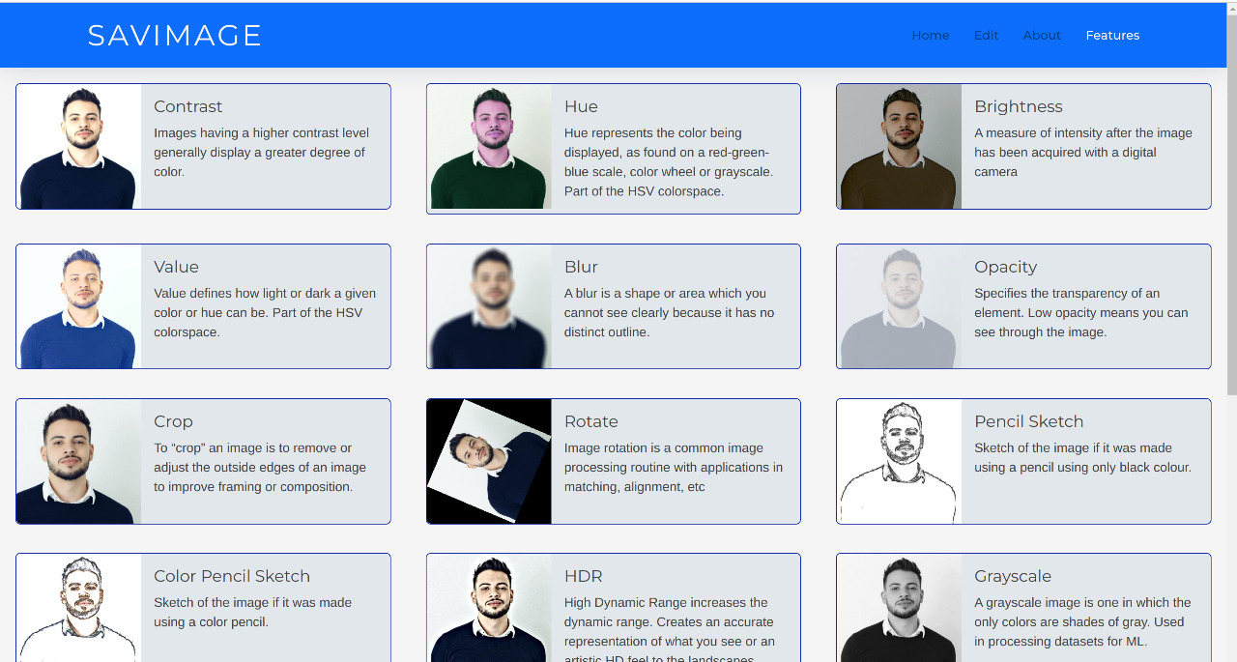
BASIC FILTERS

Slide 6
IMAGE TRANSFORMATION

Slide 7
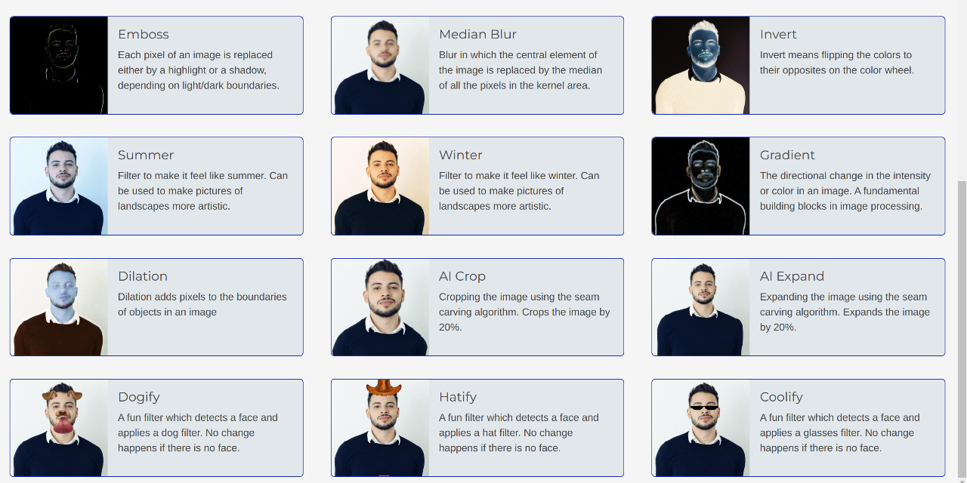
AI FILTERS

Slide 8
ADVANCED FILTERS

Slide 9
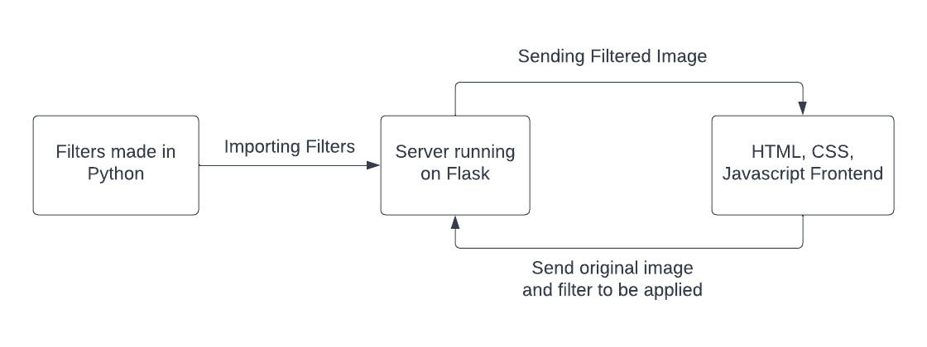
PROJECT ARCHITECTURE

Slide 10
THANK YOU

